Slide 1
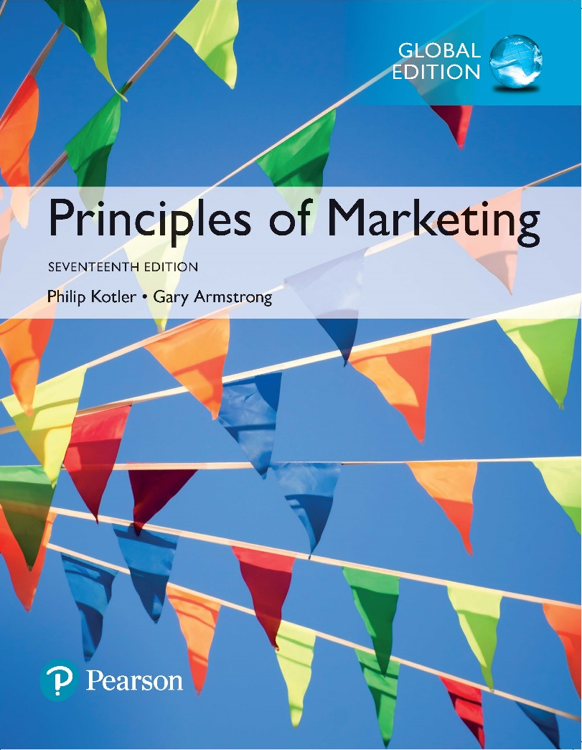
Principles of Marketing Seventeenth Edition
Chapter 3
Analyzing the Marketing Environment
Copyright © 2018 Pearson Education Ltd. All Rights Reserved.

Slide 2
Learning Objectives
3-1 Describe the environmental forces that affect the company’s ability to serve its customers.
3-2 Explain how changes in the demographic and economic environments affect marketing decisions.
3-3 Identify the major trends in the firm’s natural and technological environments.
3-4 Explain the key changes in the political and cultural environments.
3-5 Discuss how companies can react to the marketing environment.

Slide 3
Learning Objective 1
Describe the environmental forces that affect the company’s ability to serve its customers.

Slide 4
A Company’s Marketing Environment
The marketing environment includes the actors and forces outside marketing that affect marketing management’s ability to build and maintain successful relationships with target customers.
Notes:
Marketers must be environmental trend trackers and opportunity seekers.
By carefully studying the environment, marketers can adapt their strategies to meet new marketplace challenges and opportunities.
By using marketing research and marketing intelligence, companies constantly watch and adapt to the changing environment—or like Microsoft, in many cases, lead those changes.

Slide 5
A Company’s Marketing Environment
Microenvironment consists of the actors close to the company that affect its ability to serve its customers—the company, suppliers, marketing intermediaries, customer markets, competitors, and publics.
Macroenvironment consists of the larger societal forces that affect the microenvironment—demographic, economic, natural, technological, political, and cultural forces.

Slide 6
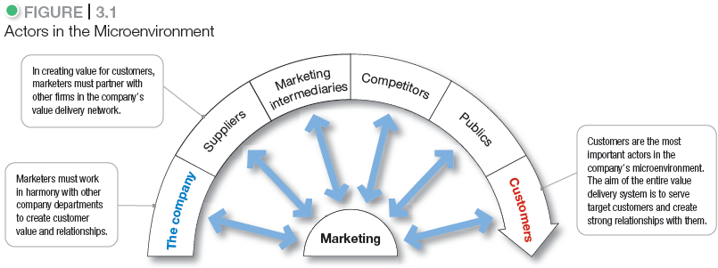
The Microenvironment
Notes:
Marketing management’s job is to build relationships with customers by creating customer value and satisfaction. However, marketing managers cannot do this alone.
Figure 3.1 shows the major actors in the marketer’s microenvironment. Marketing success requires building relationships with other company departments, suppliers, marketing intermediaries, competitors, various publics, and customers, which combine to make up the company’s value delivery network.

Slide 7
The Microenvironment
The Company
In designing marketing plans, marketing management takes other company groups into account.
Top management
Finance
R&D
Purchasing
Operations
Accounting
Notes:
All of these interrelated company groups form the internal environment, the microenvironment. With marketing taking the lead, all departments—from manufacturing and finance to legal and human resources—share the responsibility for understanding customer needs and creating customer value.
Discussion Questions
What type of collaboration does there need to be between the departments?
How might projects be integrated between marketing and finance?
How might projects be integrated between marketing and information systems?
This question on finance could lead to a discussion about budgeting for marketing. The collaboration between marketing and IS could lead to discussions of market research, ordering systems, and customer relationship management systems.

Slide 8
The Microenvironment
Suppliers
Provide the resources to produce goods and services
Treat as partners to provide customer value
Notes:
Suppliers form an important link in the company’s overall customer value delivery network. Supplier problems can seriously affect marketing.
Marketing managers must watch supply availability and costs. Supply shortages or delays, labor strikes, natural disasters, and other events can cost sales in the short run and damage customer satisfaction in the long run. Rising supply costs may force price increases that can harm the company’s sales volume.

Slide 9
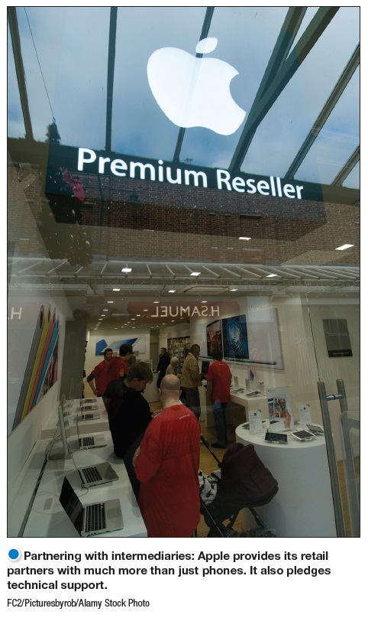
The Microenvironment
Marketing Intermediaries
Marketing intermediaries are firms that help the company to promote, sell, and distribute its goods to final buyers.
Notes:
Marketing intermediaries help the company promote, sell, and distribute its products to final buyers. They include resellers, physical distribution firms, marketing services agencies, and financial intermediaries.
The text explains how Coke delivers value for their marketing intermediaries:
They understand each retailer partner’s business.
The conduct consumer research and share with partners.
They develop marketing programs and merchandising for partners.

Slide 10
The Microenvironment
Marketing Intermediaries
Resellers
Physical distribution firms
Marketing services agencies
Financial intermediaries
Notes:
Types of Marketing Intermediaries
Resellers are distribution channel firms that help the company find customers or make sales to them. Large and growing reseller organizations, such as Walmart and Costco, frequently have enough power to dictate terms or even shut smaller manufacturers out of large markets.
Physical distribution firms help the company stock and move goods from their points of origin to their destinations.
Marketing services agencies are the marketing research firms, advertising agencies, media firms, and marketing consulting firms that help the company target and promote its products to the right markets.
Financial intermediaries include banks, credit companies, insurance companies, and other businesses that help finance transactions or insure against the risks associated with the buying and selling of goods.
Like suppliers, marketing intermediaries form an important component of the company’s overall value delivery network, and marketers recognize the importance of working with their intermediaries as partners rather than simply as channels through which they sell their products.

Slide 11
The Microenvironment
Competitors
Firms must gain strategic advantage by positioning their offerings strongly against competitors’ offerings in the minds of consumers.
Notes:
Students should note that the competition is just a click away with online purchasing.
The marketing concept states that, to be successful, a company must provide greater customer value and satisfaction than its competitors do.
Marketers must gain strategic advantage by positioning their offerings strongly against competitors’ offerings in the minds of consumers.
No single competitive marketing strategy is best for all companies. Each firm should consider its own size and industry position compared to those of its competitors.

Slide 12
The Microenvironment
Publics
Any group that has an actual or potential interest in or impact on an organization’s ability to achieve its objectives:
Financial publics
Media publics
Government publics
Citizen-action publics
Local publics
General public
Internal publics
Notes:
Financial publics. This group influences the company’s ability to obtain funds.
Media publics. This group carries news, features, and editorial opinion.
Government publics. Management must take government developments into account.
Citizen-action publics. A company’s marketing decisions may be questioned by consumer organizations, environmental groups, minority groups, and others.
Local publics. This group includes neighborhood residents and community organizations.
General public. A company needs to be concerned about the general public’s attitude toward its products and activities.
Internal publics. This group includes workers, managers, volunteers, and the board of directors.
A company can prepare marketing plans for these major publics as well as for its customer markets. The company would have to design offers to these publics that are attractive enough to produce the desired response.

Slide 13
The Microenvironment
Customers
Consumer markets
Business markets
Reseller markets
Government markets
International markets
Notes:
Consumer markets consist of individuals.
Business markets buy goods and services for further processing or use in their production processes.
Reseller markets buy goods and services to resell at a profit.
Government markets consist of government agencies that buy goods and services to produce public services or transfer the goods and services to others who need them.
International markets consist of various buyers in other countries, including consumers, producers, resellers, and governments.
Each market type has special characteristics that call for careful study by the seller.

Slide 14
Learning Objective 2
Explain how changes in the demographic and economic environments affect marketing decisions.

Slide 15
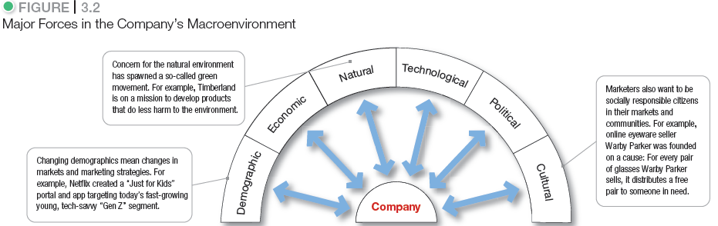
The Macro environment
Notes:
As shown in Figure 3.2, the company and all of the other actors operate in a larger macroenvironment of forces that shape opportunities and pose threats to the company.
Even the most dominant companies can be vulnerable to the often turbulent and changing forces in the marketing environment. Some of these forces are unforeseeable and uncontrollable. Others can be predicted and handled through skillful management.
Companies that understand and adapt well to their environments can thrive. Those that don’t can face difficult times.

Slide 16
The Macroenvironment
Demographic Environment
Demography is the study of human populations—size, density, location, age, gender, race, occupation, and other statistics.
Demographic environment involves people, and people make up markets.
Demographic trends include changing age and family structures, geographic population shifts, educational characteristics, and population diversity.
Notes:
The demographic environment is of major interest to marketers because it involves people, and people make up markets.
Marketers keep a close eye on demographic trends and developments in their markets and analyze changing age and family structures, geographic population shifts, educational characteristics, and population diversity.

Slide 17

The Macroenvironment
Economic Environment
Notes:
You’d expect value pitches from the sellers of
everyday products. For example, as Target has
shifted emphasis toward the “Pay Less” side of its
“Expect More. Pay Less.” slogan, the once-chic headlines
at the Target.com website have been replaced by
more practical appeals such as “Our lowest prices of
the season,” “Slam dunk deals,” and “Free shipping,
every day.”

Slide 18
The Macroenvironment
Economic Environment
Changes in Consumer Spending
Value marketing involves offering financially cautious buyers greater value—the right combination of quality and service at a fair price.
Notes:
Discussion Questions
What changes might there be in U.S. income over the next year?
What are positioned as “value cars”?
The students might quote current economic declines or rises. The “value cars” will probably include some of the smaller cars by Kia, Ford, Honda, and Toyota.
Economic factors can have a dramatic effect on consumer spending and buying behavior. For example, until fairly recently, American consumers spent freely, fueled by income growth, a boom in the stock market, rapid increases in housing values, and other economic good fortunes. They bought and bought, seemingly without caution, amassing record levels of debt. However, the free spending and high expectations of those days were dashed by the Great Recession of 2008/2009.

Slide 19
The Macroenvironment
Economic Environment
Income Distribution
Over the past several decades, the rich have grown richer, the middle class has shrunk, and the poor have remained poor.
Notes:
Marketers should pay attention to income distribution as well as income levels.
This distribution of income has created a tiered market. Many companies—such as Nordstrom and Neiman Marcus—aggressively target the affluent. Others—such as Dollar General and Family Dollar—target those with more modest means.
Some companies tailor their market offerings across a range of markets, from the affluent to the less affluent. For example, Ford offers cars ranging from the low-priced Ford Fiesta, starting at $13,200, to the luxury Lincoln Navigator SUV, starting at $57,775.
Changes in major economic variables, such as income, cost of living, interest rates, and savings and borrowing patterns, have a large impact on the marketplace. Companies watch these variables by using economic forecasting so they do not have to be wiped out by an economic downturn or caught short in a boom.

Slide 20
Learning Objective 3
Identify the major trends in the firm’s natural and technological environments.

Slide 21
The Macroenvironment
The Natural Environment
The natural environment is the physical environment and the natural resources that are needed as inputs by marketers or that are affected by marketing activities.

Slide 22
The Macroenvironment
The Natural Environment
Trends in the Natural Environment
Growing shortages of raw materials
Increased pollution
Increased government intervention
Developing strategies that support environmental sustainability
Notes:
Marketers should be aware of several trends in the natural environment.
First, there are growing shortages of raw materials. Air and water may seem to be infinite resources, but some groups see long-run dangers. Renewable resources, such as forests and food, also have to be used wisely. Nonrenewable resources, such as oil, coal, and various minerals, pose a serious problem. Firms making products that require these scarce resources face large cost increases, even if the materials remain available.
A second environmental trend is increased pollution. Industry will almost always damage the quality of the natural environment. Consider the disposal of chemical and nuclear wastes; chemical pollutants in the soil and food supply; and the littering of the environment with non-biodegradable packaging materials.
A third trend is increased government intervention in natural resource management. The governments of different countries vary in their concern and efforts to promote a clean environment. The Environmental Protection Agency (EPA) was created in 1970 to create and enforce pollution standards and conduct pollution research.
Many companies are developing strategies that support environmental sustainability.

Slide 23
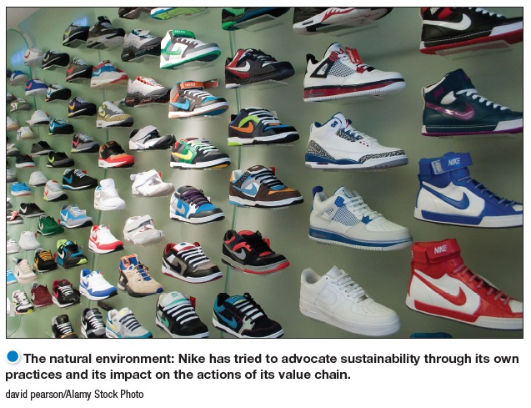
The Macroenvironment
Natural Environment
Environmental sustainability involves developing strategies and practices that create a world economy that the planet can support indefinitely.
Notes:
Concern for the natural environment has spawned the so-called green movement and the development of strategies and practices that support environmental sustainability.
Environmental sustainability means meeting present needs without compromising the ability of future generations to meet their needs.
Many companies are responding to consumer demands with more environmentally responsible products. Others are developing recyclable or biodegradable packaging, recycled materials and components, better pollution controls, and more energy-efficient operations.
Companies today are looking to do more than just good deeds. More and more, they are recognizing the link between a healthy ecology and a healthy economy. They are learning that environmentally responsible actions can also be good business.

Slide 24

The Macroenvironment
Technological Environment
Most dramatic force in changing the marketplace
New products, opportunities
Concern for the safety of new products
Notes:
Discussion Question
Ask students what changes they have seen in technology in the past four years including medical products, communications, and media.
New technologies can offer exciting opportunities for marketers. Many firms are already using RFID technology radio-frequency identification to track products through various points in the distribution channel.
The technological environment changes rapidly. New technologies create new markets and opportunities. Marketers should watch the technological environment closely. Companies that do not keep up will soon find their products outdated. If that happens, they will miss new product and market opportunities.
As products and technology become more complex, the public needs to know that these items are safe. Government regulations have resulted in much higher research costs and longer times between new product ideas and their introduction. Marketers should be aware of these regulations when applying new technologies and developing new products.

Slide 25
Learning Objective 4
Explain the key changes in the political and cultural environments.

Slide 26
The Macroenvironment
Political and Social Environment
Legislation regulating business is intended to protect
companies from each other
consumers from unfair business practices
the interests of society against unrestrained business behavior
Notes:
The political environment includes laws, government agencies, and pressure groups that influence or limit various organizations and individuals in a given society.
Even the strongest advocates of free-market economies agree that the system works best with at least some regulation. Well-conceived regulation can encourage competition and ensure fair markets for goods and services.
Thus, governments develop public policy to guide commerce—sets of laws and regulations that limit business for the good of society as a whole. Almost every marketing activity is subject to a wide range of laws and regulations.
Legislation affecting business around the world has increased steadily over the years. The United States and many other countries have many laws covering issues such as competition, fair trade practices, environmental protection, product safety, truth in advertising, consumer privacy, packaging and labeling, pricing, and other important areas.

Slide 27

The Macroenvironment
Political and Social Environment
Increased emphasis on ethics
Socially responsible behavior
Cause-related marketing
Notes:
Cause-related marketing: Eyewear company Warby Parker offers designer glasses at a revolutionary low price while also leading the way for socially conscious businesses. For every pair of glasses sold, Warby Parker distributes a pair to someone in need.
Written regulations cannot possibly cover all potential marketing abuses, and existing laws are often difficult to enforce. However, beyond written laws and regulations, business is also governed by social codes and rules of professional ethics.
Socially Responsible Behavior. Enlightened companies encourage their managers to look beyond what the regulatory system allows and simply “do the right thing.”
Cause-Related Marketing. To exercise their social responsibility and build more positive images, many companies are now linking themselves to worthwhile causes. It has become a primary form of corporate giving which lets companies “do well by doing good” by linking purchases of the company’s products or services with benefiting worthwhile causes or charitable organizations.
Cause-related marketing has stirred some controversy. Critics worry that cause-related marketing is more a strategy for selling than a strategy for giving—that “cause-related” marketing is really “cause-exploitative” marketing.

Slide 28
The Macroenvironment
Cultural Environment
The cultural environment consists of institutions and other forces that affect a society’s basic values, perceptions, and behaviors.
Notes:
Cultural factors strongly affect how people think and how they consume, so marketers are keenly interested in cultural forces.

Slide 29
The Macroenvironment
Cultural Environment
Core beliefs and values are persistent and are passed on from parents to children and are reinforced by schools, churches, businesses, and government.
Secondary beliefs and values are more open to change and include people’s views of themselves, others, organizations, society, nature, and the universe.
Notes:
The cultural environment consists of institutions and other forces that affect a society’s basic values, perceptions, preferences, and behaviors. People grow up in a particular society that shapes their basic beliefs and values. They absorb a worldview that defines their relationships with others. Cultural characteristics can affect marketing decision making.
People in a given society hold many beliefs and values. Their core beliefs and values have a high degree of persistence. For example, most Americans believe in individual freedom, hard work, getting married, and achievement and success. These beliefs shape more specific attitudes and behaviors found in everyday life.
Secondary beliefs and values are more open to change. Believing in marriage is a core belief; believing that people should get married early in life is a secondary belief. Marketers have some chance of changing secondary values but little chance of changing core values.

Slide 30
Learning Objective 5
Discuss how companies can react to the marketing environment.

Slide 31
Responding to the Marketing Environment
Views on Responding
Uncontrollable
React and adapt to forces in the environment
Proactive
Take aggressive actions to affect forces in the environment
Reactive
Watch and react to forces in the environment
Notes:
Someone once observed, “There are three kinds of companies: those who make things happen, those who watch things happen, and those who wonder what’s happened.”
Many companies view the marketing environment as an uncontrollable element. They passively accept the marketing environment, analyze environmental forces and design strategies that will help the company avoid the threats and take advantage of the opportunities the environment provides.
Other companies take a proactive stance toward the marketing environment. Rather than assuming that strategic options are bounded by the current environment, these firms develop strategies to change the environment and overcome seemingly uncontrollable environmental events.
“Business history . . . reveals plenty of cases in which firms’ strategies shape industry structure,” says the expert, “from Ford’s Model T to Nintendo’s Wii.”
Marketing management cannot always control environmental forces. In many cases, it must settle for simply watching and reacting to the environment. But whenever possible, smart marketing managers take a proactive rather than a reactive approach to the marketing environment

